Slide 1
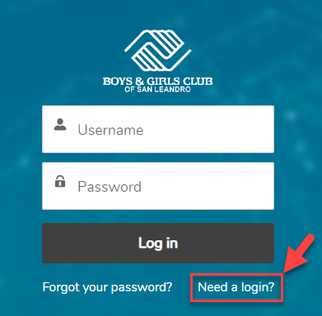
Create a login by selecting the “Need a Login?” option above.
Complete Parents/Guardians Create Account Information form.
Once completed, you will receive a confirmation email in your inbox MyClubHub Parent Portal. Click the link in the email to log into the Parent Portal.

Slide 2
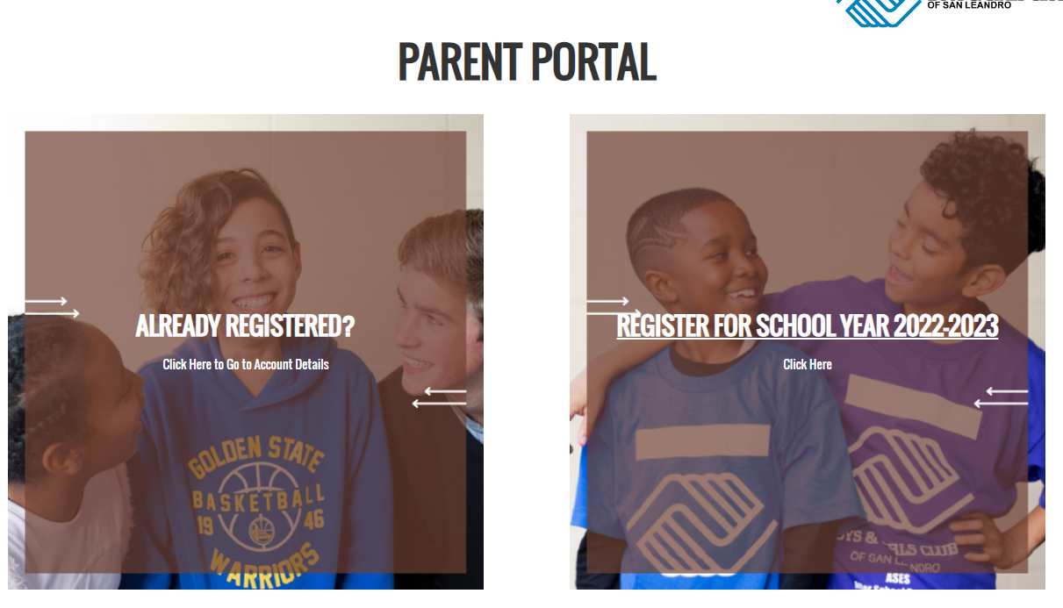
Select Register For School Year 2022-2023

Slide 3
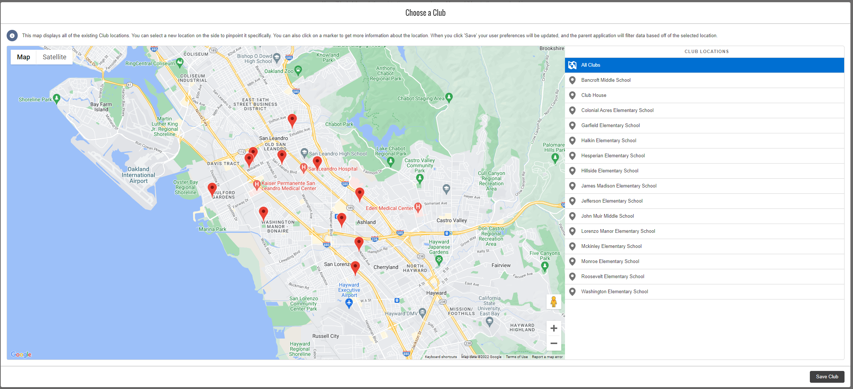
Select your New/Returning Club Site then select Save Club

Slide 4
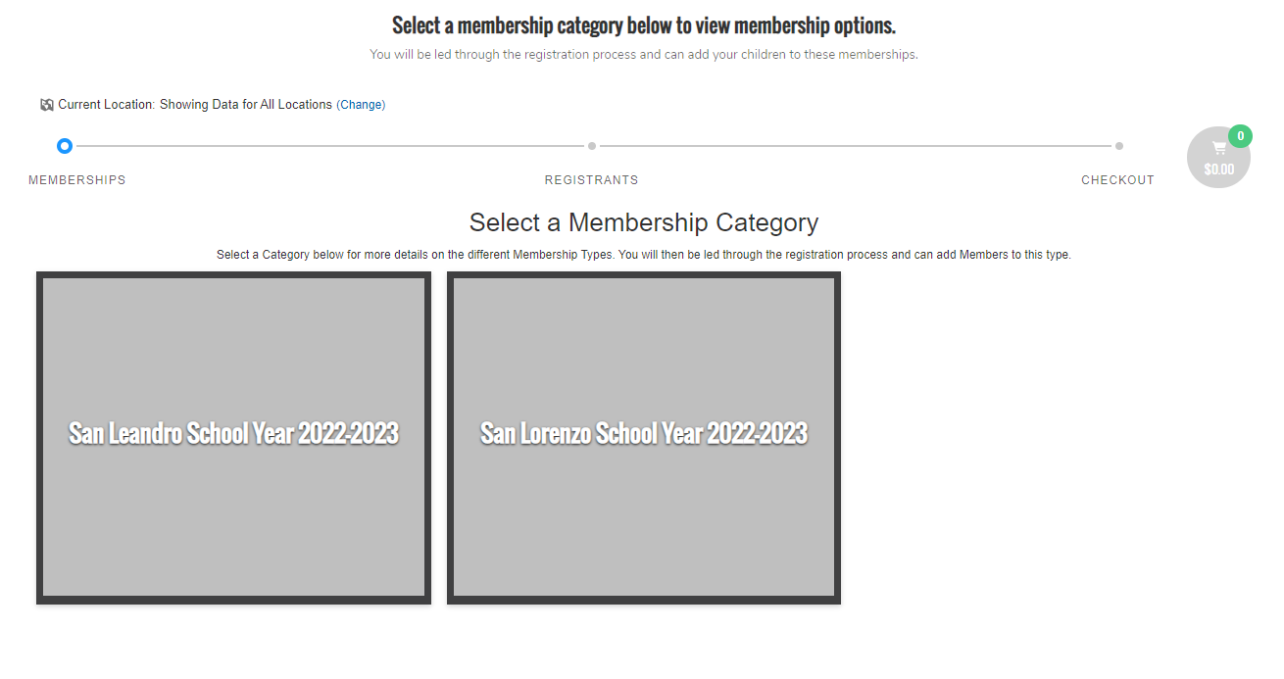
The Location selected, will take you to either San Leandro or San Lorenzo School Year 2022-2023

Slide 5
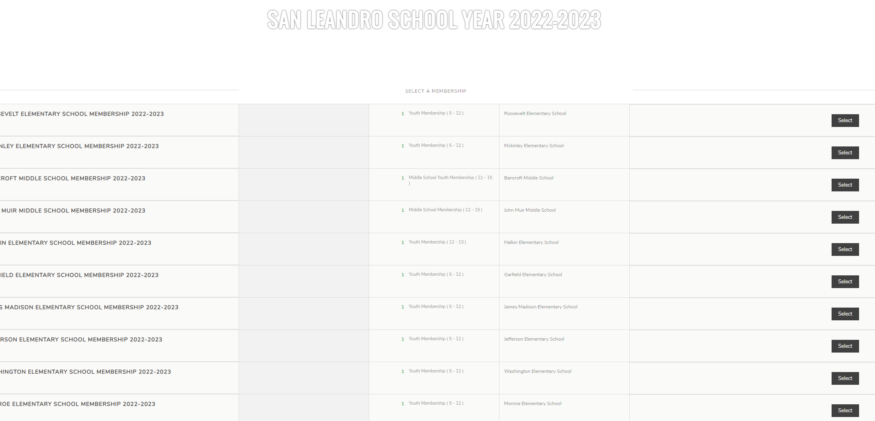
Select your School Site .
*Please note that below is only an example. When selecting the club location - Slide 3 the system will automatically save your schools site to be selected.

Slide 6
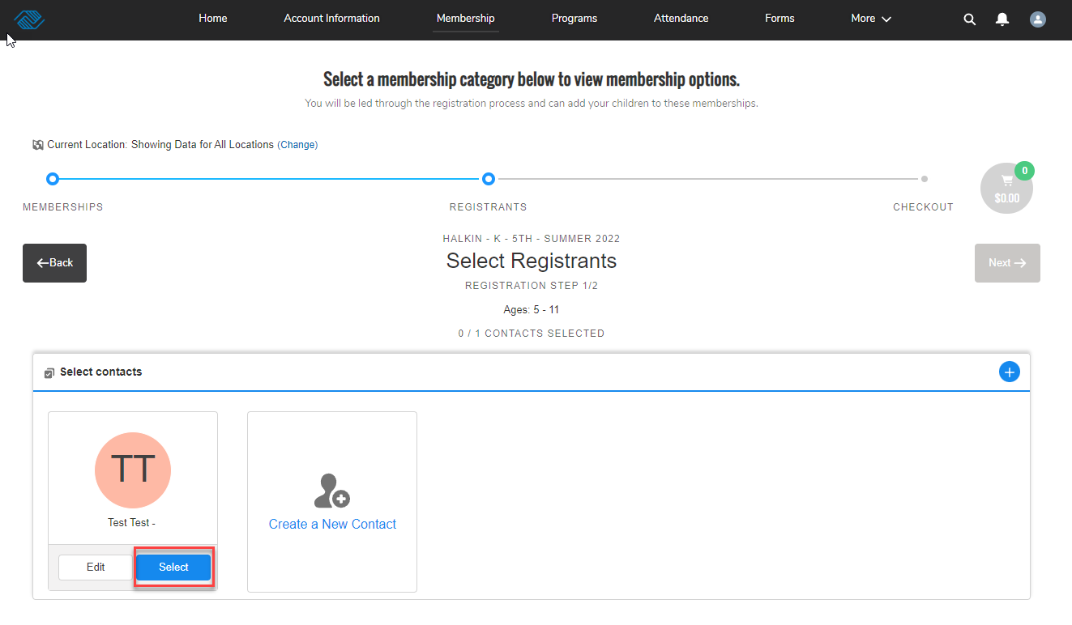
Select current club member(s) or create a new contact when adding a club member(s) to the program or waitlist.

Slide 7
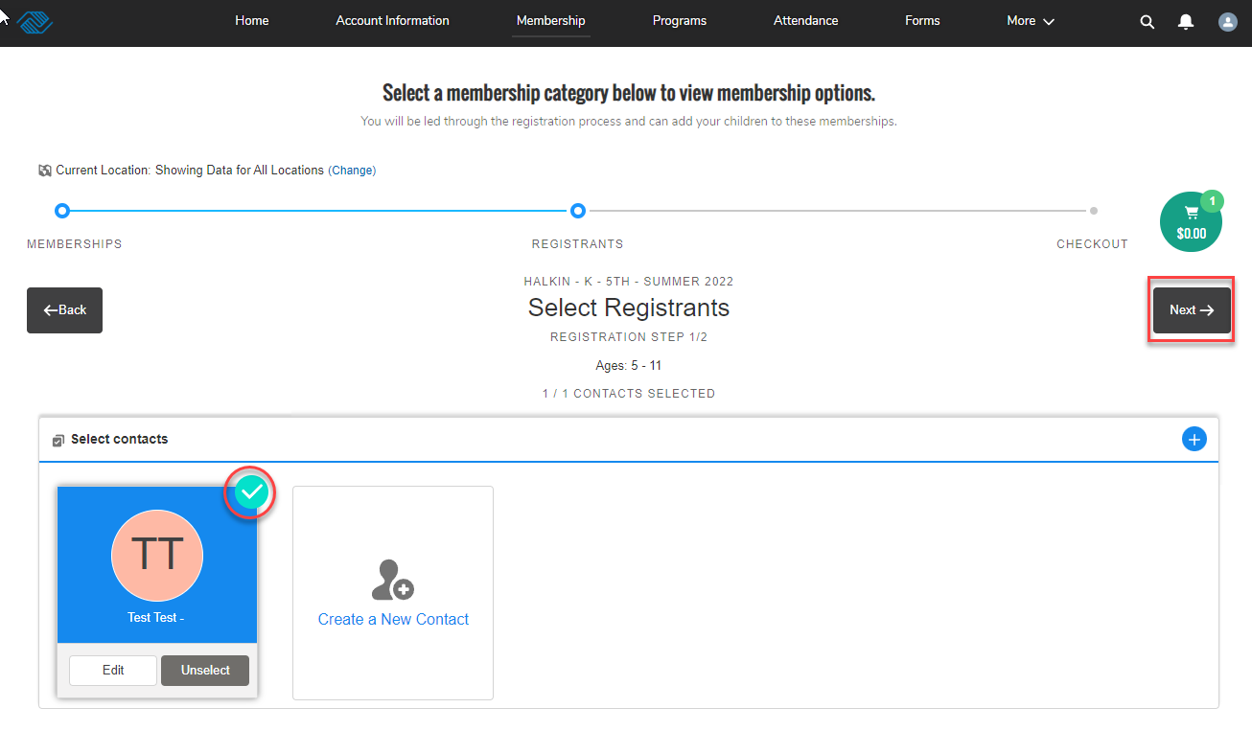
Select club member(s) then click next

Slide 8
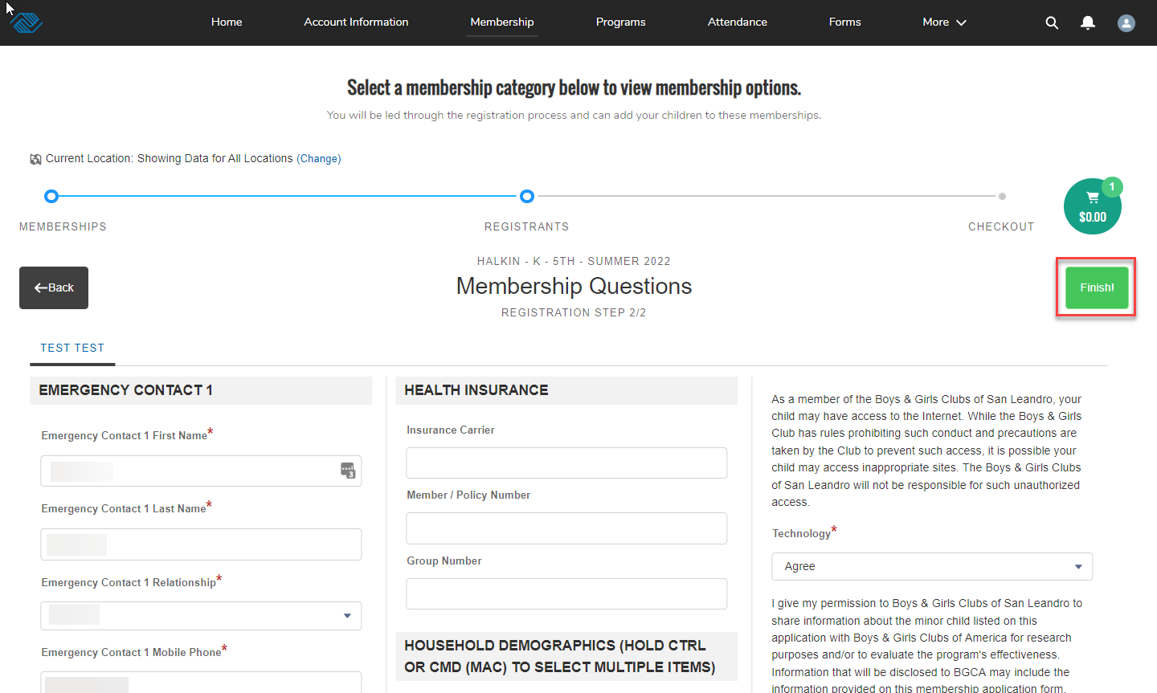
Answer ALL club member membership questions. Select finish after completed.
*Please take your time in selecting and answering all fields noted by the red star. Failure to do so will
Result in an Error Message. If there is an error message, double check fields and make certain you answer
Or select the option that best supports club member(s)

Slide 9
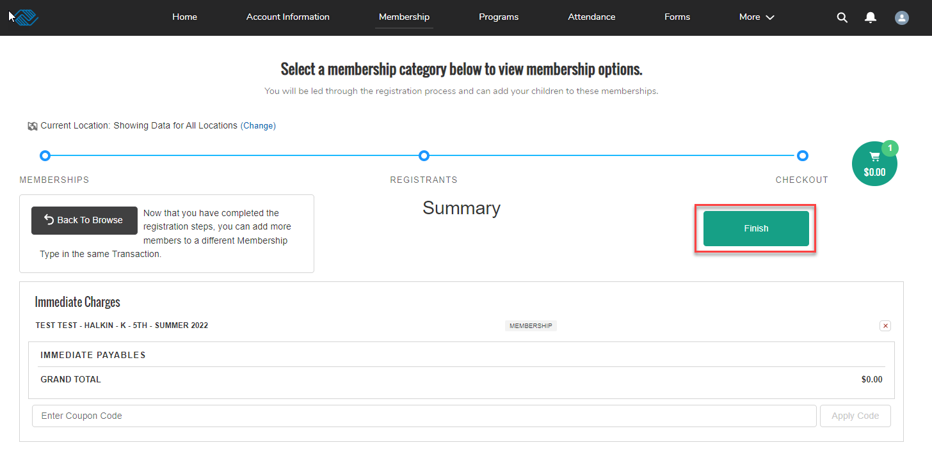
Select Finish

Slide 10
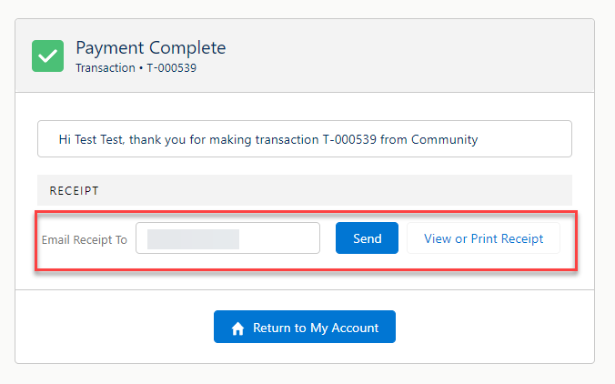
Confirmation no cost receipt and text will be sent.
There is no cost for the 2022-2023 school year membership program.
*If this is a waitlisted membership, program start date and details will be
communicated by BGCSL staff.

Slide 11
Congratulations!
If you run into any challenges or error messages, please contact Akin Joseph akin@bgcsl.org.
Note: your application has been received. You will receive an email confirming your child(ren)’s spot at one of our Clubs. If the program you are applying for has reached capacity, they will be placed on a Waitlist.
Great Futures Start Here!

